Slide 1
KUBERNETES
By:
Prathmesh Dalve
Dhiraj Deore

Slide 2
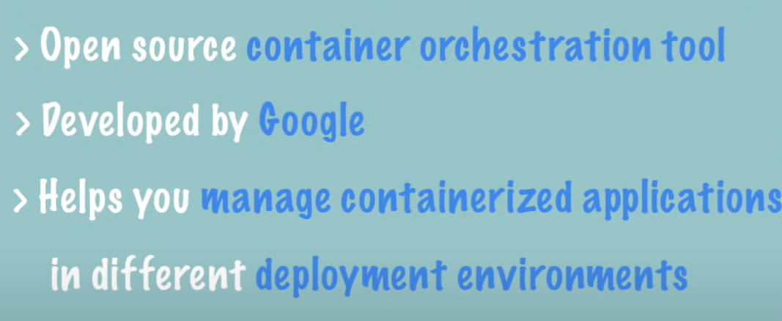
What is kubernetes

Slide 3
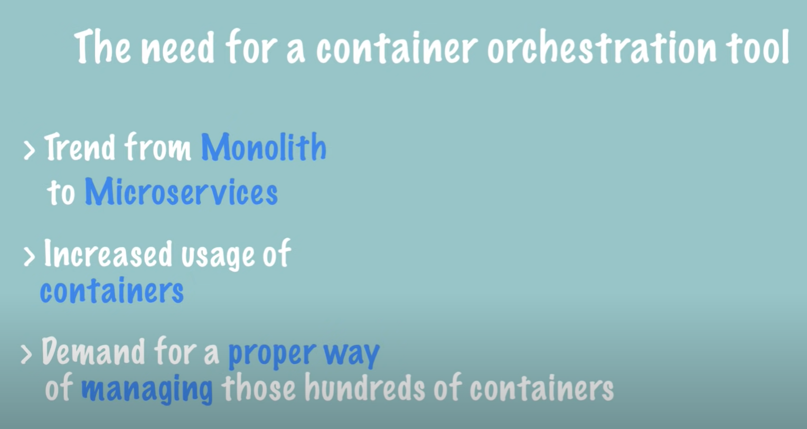

Slide 4
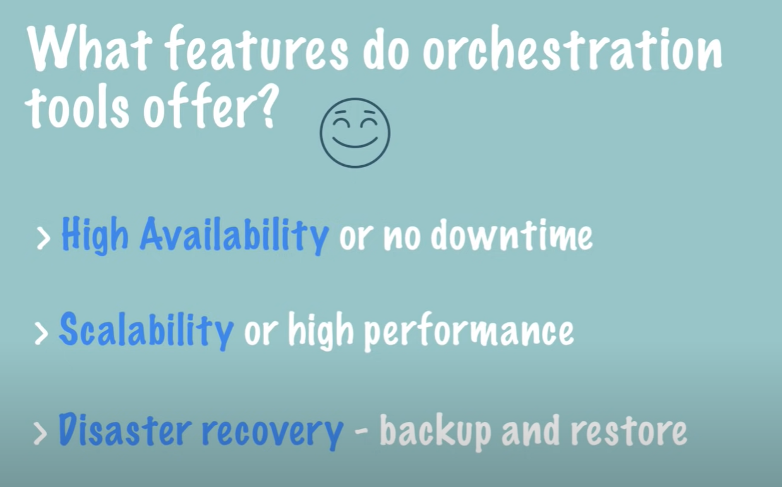

Slide 5
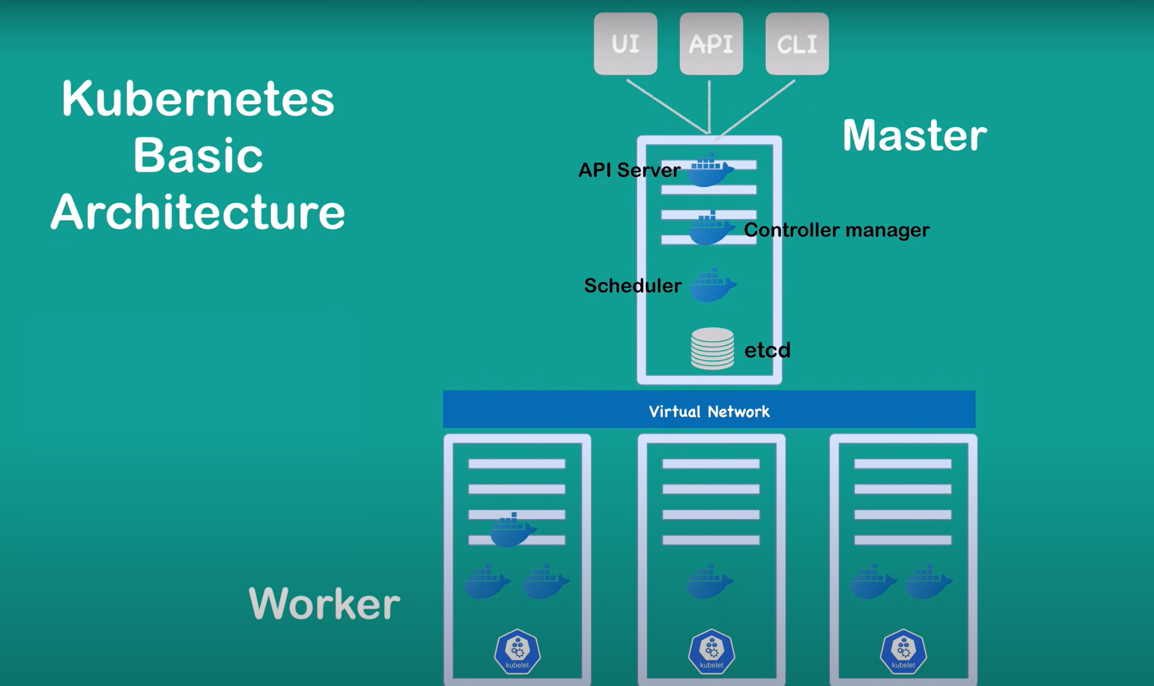

Slide 6
NODE:
► A Node is a worker machine in Kubernetes and may be either a virtual or a
physical machine, depending on the cluster.
► Each Node is managed by the control plane.
► A Node can have multiple pods, and the Kubernetes control plane
automatically handles scheduling the pods across the Nodes in the cluster.
► There are two types of nodes:
- Master Node
- Worker Node

Slide 7
MASTER NODE:
The master node is responsible for running several Kubernetes processes that are necessary to run and manage the cluster properly
WORKER NODE:
The worker nodes are part of the Kubernetes clusters which actually execute the containers and applications on them.

Slide 8
A master node has the following components to help manage worker nodes:
API Server –
Acts as the frontend to the cluster. All external communication to
the cluster is via the API Server.
2. Scheduler –
Scheduler ensures proper pod placement on the worker nodes
based on several factors such as the available resources and the current load on the cluster.

Slide 9
3. Controller Manager –
This keeps track of the state of the cluster. It keeps an eye on the cluster and checks whether a node needs to be repaired or restarted.
4. Etcd –
Kubernetes uses etcd to store all its data – its configuration data, its state, and its metadata. Kubernetes is a distributed system, so it needs a distributed data store like etcd. Etcd lets any of the nodes in the Kubernetes cluster read and write data.

Slide 10
They have two main components on worker node, the Kubelet Service and the Kube-proxy Service:
1. Kubelet Service –
Each worker node has a Kubelet process running on it that allows the cluster to talk to each other and execute some tasks on the worker nodes, such as running application processes. It listens for instructions from the API Server and manages containers running on the node.
2. Kube-proxy Service –
The Kube-Proxy Service is responsible for enabling communication between services within the cluster.

Slide 11
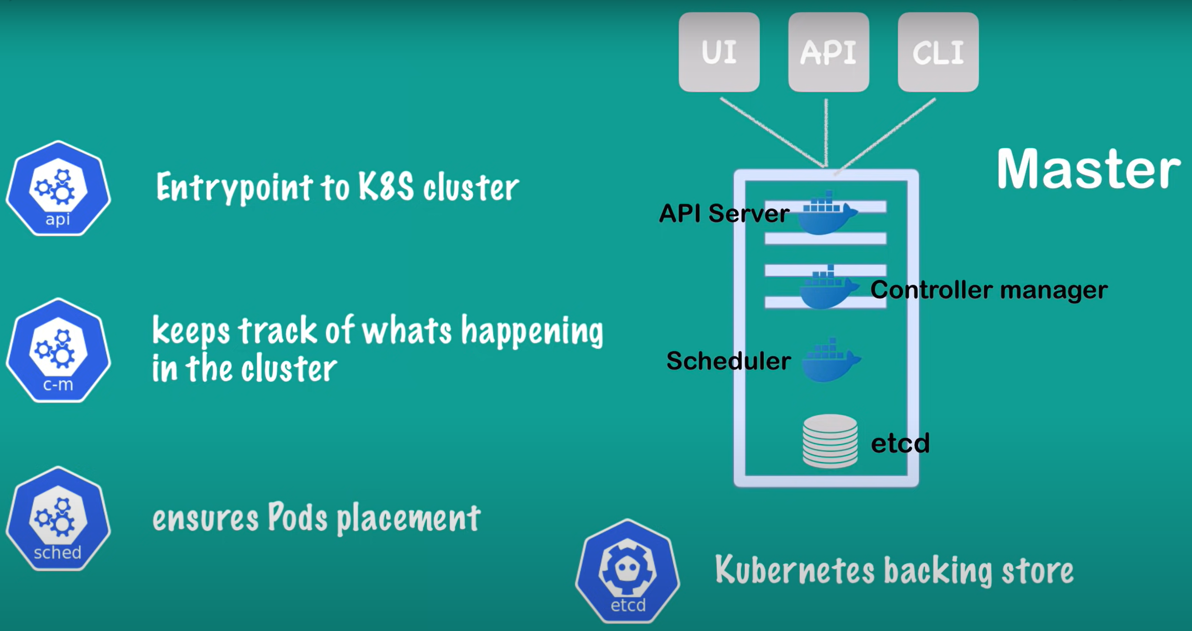

Slide 12
POD:
► A Pod is a collection of containers and its storage inside a node of a Kubernetes cluster. It is possible to create a pod with multiple containers inside it.
► For example, keeping a database container and data container in the same pod.

Slide 13
Commands for Kubernetes:
► Get version-related information:
kubectl version
► Get configuration details:
kubectl config view
► Create deployment:
kubectl create deploy <deploy name> -image=<image name>
► List all current pods:
kubectl get pods
► Describe pod names:
kubectl describe pod<name>

